Slide 1

Speech Emotion Recognition using Convolutional Neural Networks
Somayeh (Bahar) Shahsavarani
A Thesis Defense
Under the supervision of Professor Stephen Scott
Computer Science
College of Arts and Sciences
University of Nebraska-Lincoln
March 16, 2018

Slide 2
Human Brain and Artificial Intelligence
Human brain, an intricate organ, strongly competent to learn high-level abstract concepts from experiencing low- level information processed by sensory periphery:
  Recognizing faces from visual sensory inputs
  Understanding language from auditory sensory inputs

Slide 3
Human Brain and Artificial Intelligence
Human brain, an inspiration for research in artificial intelligence (AI) trying to mimic human intelligence
AI aims to develop intelligent systems that are able to generate rational thoughts and behaviors similar to human thought and performance

Slide 4
Research Areas in AI
Computer vision
Machine listening
Natural language processing
Automated reasoning
Machine learning
Robotics

Slide 5
Automatic Speech Recognition (ASR)
Speech:
  The most natural and convenient way by which humans communicate
Speech perception:
  One of the most intricate processes that human brain performs
ASR, an active field of AI research aiming to generate machines that communicate with people via speech
Notes:
Developing machines that interact with humans by understanding speech pave the way for building systems that are equipped with human-like intelligence.

Slide 6
Linguistic vs Paralinguistic Information
Speech, an information-rich signal containing paralinguistic information as well as linguistic information:
  Identity
  Gender
  Intention
  Mood
  Emotion
Notes:
Paralinguistic information were mostly ignored by the classical ASR framework.

Slide 7
Linguistic vs Paralinguistic Information
Understand the underlying meaning of the utterances and having effective communication:
  Employing both linguistic and paralinguistic information
Deficit in the perception of paralinguistic features
  Adverse effect on the quality of communication
  Poor social skills or even psychopathological symptoms

Slide 8
The Significance of Emotion Recognition Studies
Recognizing the emotional states of speech, a crucial key in an effective communication
  Developing machines that understand paralinguistic information such as emotion is imperative for establishing a clear, effective, and human-like communication

Slide 9
Automatic Emotion Recognition (AER)
Emotion recognition has been the subject of research for years
  Facial expressions
  Biological measurements (e.g., heart beats, skin resistance)
  Speech signals

Slide 10
Speech Emotion Recognition (SER)
Traditional approach
  Feature extraction
    Speaking rate, intonation, energy, formant frequencies, fundamental frequency (pitch), intensity (loudness), duration (length), and spectral characteristic (timbre)
  Developing classifiers
    Hidden Markov models (HMM), Gaussian mixture models, nearest neighborhood classifiers, linear discriminant classifiers, artificial neural networks, and support vector machines
Modern approach (deep learning)
  Diminishing the need for “hand-crafted” features
  learning low-level features from training data in the lower layers and building high-level representation in the upper layers
Notes:
The performance of these classifiers mostly depends on the feature extraction techniques and the features that are considered salient for a specific emotion. The acoustic correlates of emotion in speech signals vary across speakers, genders, language, and cultures. There is no universal agreement on the acoustic correlates of emotions. This results in a myriad of “hand-crafted” features depending on the speech corpus.

Slide 11
Deep Learning (DL)
A modern machine learning technique
  Artificial neural networks (ANNs) with a plethora of neurons and layers
Key concept:
  Learning complex features out of simple features
    The first layers of deep learning models represent simple and basic features of the training data. The deeper layers build a complex representation by using these low-level features
Notes:
This ability of building high-level features out of low-level features can potentially reduce the amount of preprocessing required for extracting hand-crafted features before designing classifiers.

Slide 12
Convolutional Neural Networks (CNN)
CNN is one of the most popular deep learning models manifesting remarkable success in the research areas such as:
  Object recognition, face recognition, handwriting recognition, speech recognition, and natural language processing

Slide 13
Basic Building Blocks of CNNs
Convolutional layer
  Convolution
Pooling layer
  Max pooling
  Average pooling
  Weighted average pooling
Fully connected layer

Slide 14
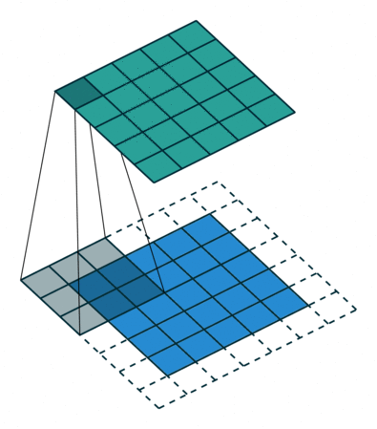
Convolution
5x5 output
5 × 5 Output
3 × 3 Kernel
5 × 5 input with zero padding
*Picture courtesy of https://github.com/vdumoulin/conv_arithmetic

Slide 15
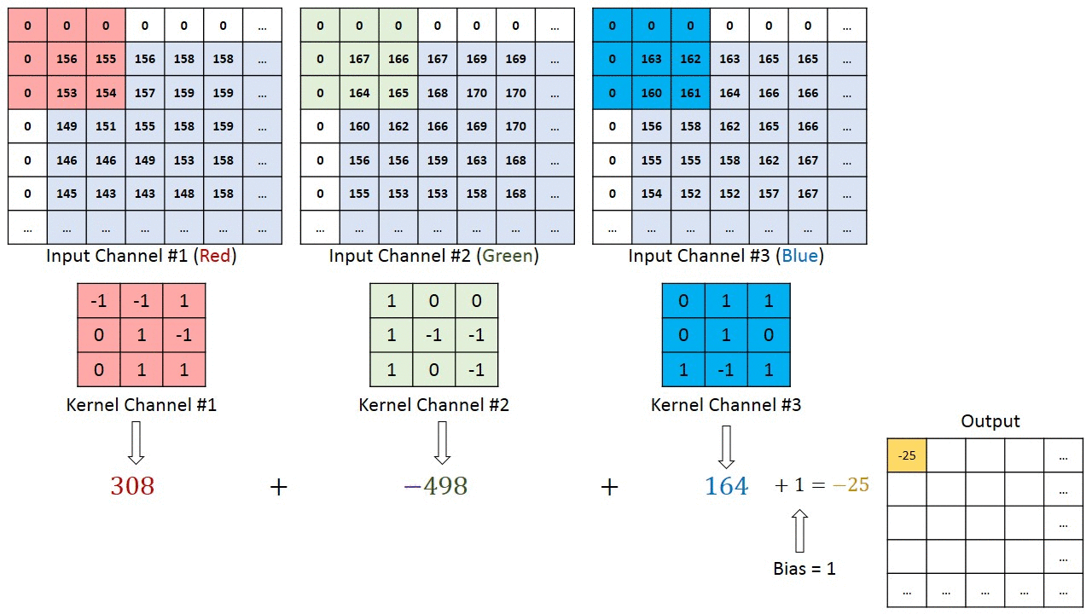
Multi-Channel Convolution
5x5 output
*Picture courtesy of http://machinelearninguru.com/_images/topics/computer_vision/basics/convolutional_layer_1/rgb.gif

Slide 16
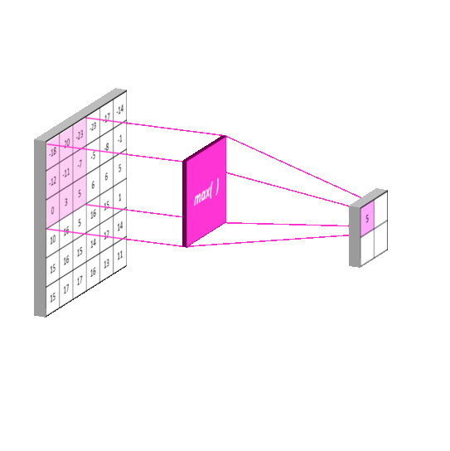
Max Pooling
*Picture courtesy of https://mlnotebook.github.io/post/CNN1

Slide 17
Goal of Study
We examined the efficacy of CNNs in decoding emotions in speech signals using spectrogram images as the inputs

Slide 18
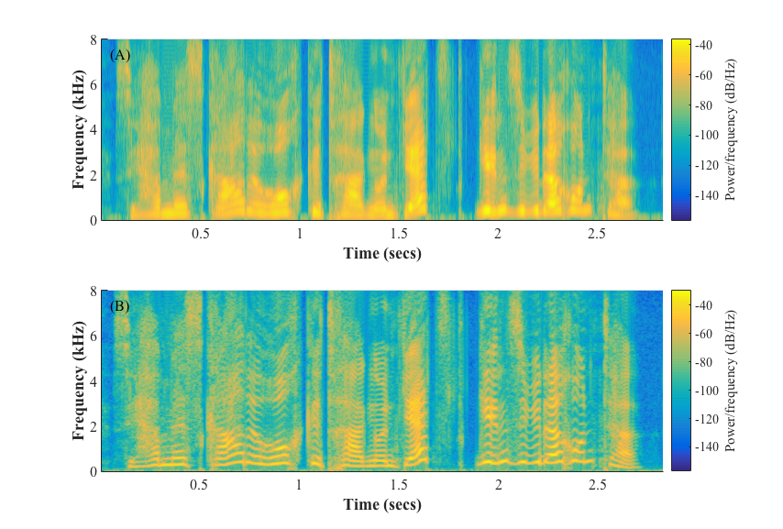
Spectrograms
Notes:
variation of energy at different frequencies across time
The vertical axis (ordinate) represents frequency and the horizontal axis (abscissa) represents time
There are two general types of spectrograms: wide-band spectrograms and narrow- band spectrograms
Wide-band spectrograms has a higher time resolution than narrow-band spectrograms. This property enables the wide-band spectrograms to show individual glottal pulses. In contrast, narrow-band spectrograms have higher frequency resolution than wide-band spectrograms. This feature enables the narrow-band spectrograms to resolve individual harmonics

Slide 19
Outline
Related Work
Experimental Setup
Results
Discussion
Conclusion
Ongoing and Future Work

Slide 20
Outline
Related Work
Experimental Setup
Results
Discussion
Conclusion
Ongoing and Future Work

Slide 21
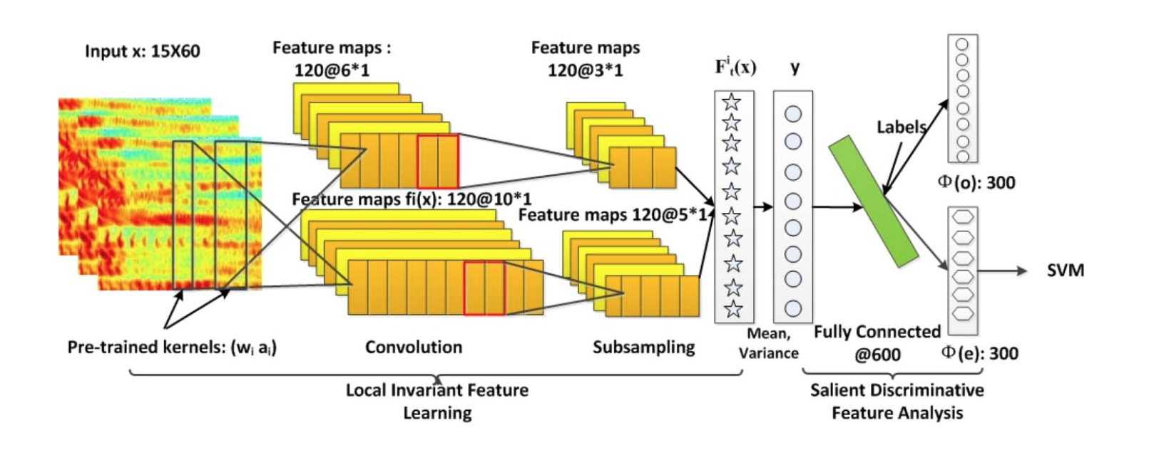
Related Work
Mao et al. (2014)

Slide 22
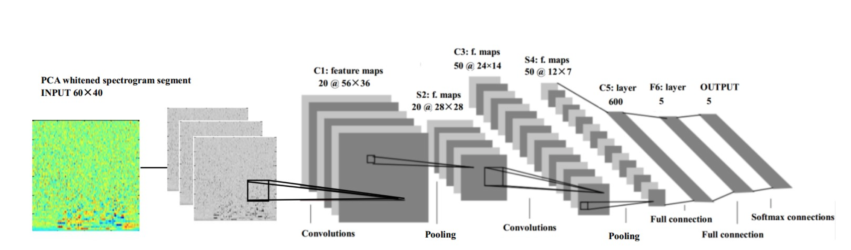
Related Work
Zheng et al. (2015)

Slide 23
Related Work
Papakostas et al. (2017)
  Four convolutional layers, each followed by a max-pooling layer
  Two fully connected layers
  To augment training data, background noise with three different levels of signal to noise ratio was added to speech signals

Slide 24
Outline
Related Work
Experimental Setup
Results
Discussion
Conclusion
Ongoing and Future Work

Slide 25
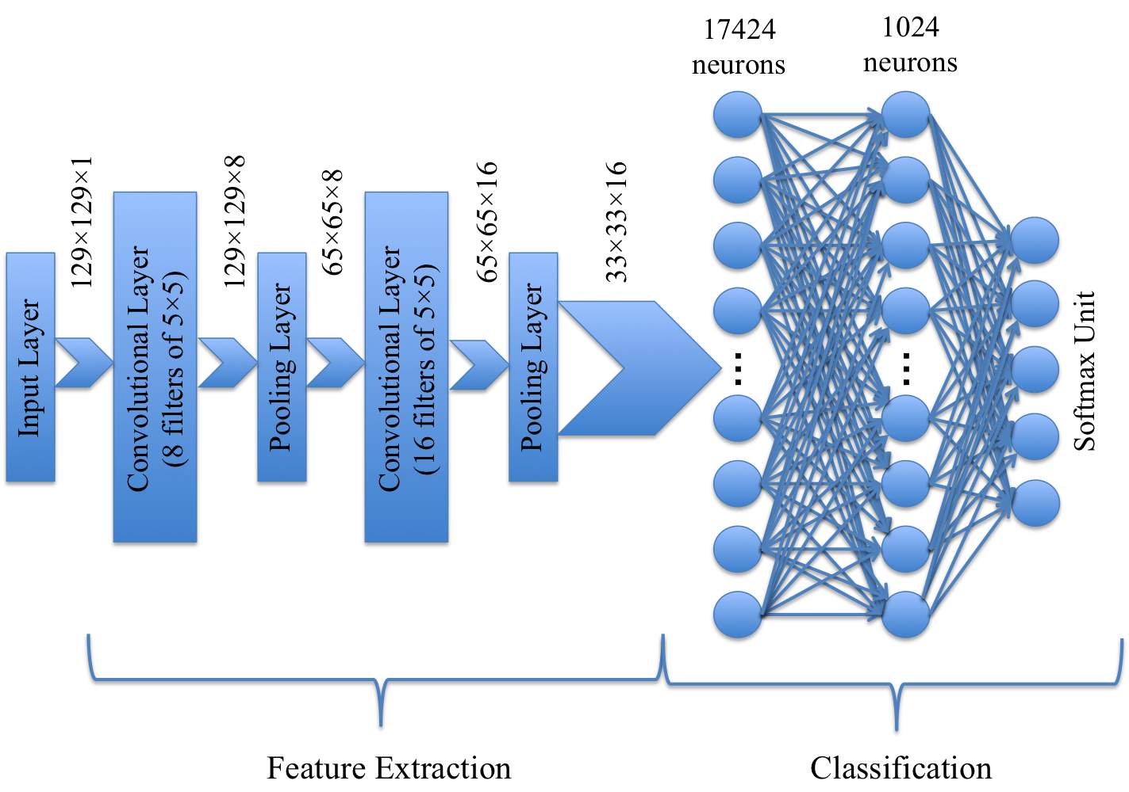
Experimental Setup: CNN Architecture

Slide 26
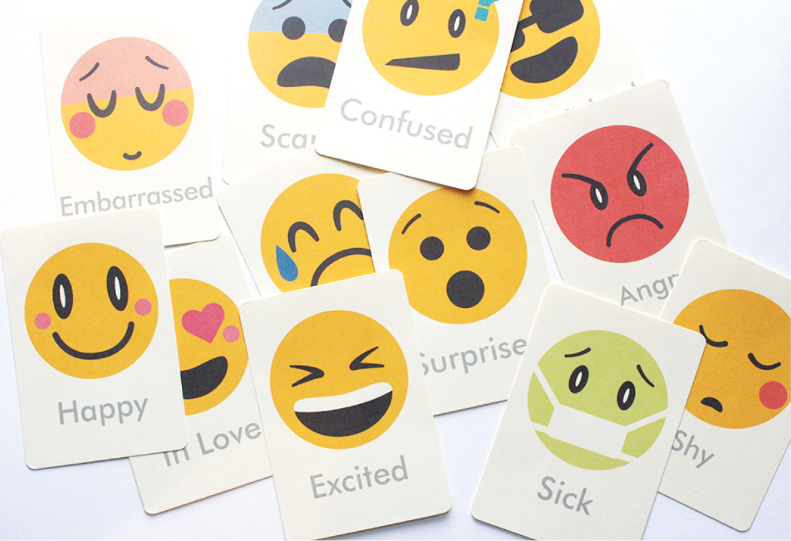
Experimental Setup: Databases
Database | Availability | Emotions | Language | Sampling Rate
EMODB | Public | 7 | German | 16 kHz
SAVEE | Public | 7 | British | 44.1 kHz
EMOVO | Public | 7 | Italian | 48 kHz
BTNRH | Private | 5 | American | 44.1 kHz
Emotions: Happy, Sad, Angry, Scared, Bored, Surprised, Disgusted, Neutral

Slide 27
Acted vs Daily-Life: 7% Rule
Speech emotion recognition is inherently a multimodal process
Other modalities such as visual or linguistic modality also contribute to convey necessary information required for recognizing emotions
  7% of the message is conveyed by verbal information, 38% by tone of voice, and 55% by body language when people communicate with one another (Mehrabian, 1971)
Notes:
Although speech modality conveys a large portion of the emotional information, it is not sufficient for recognizing affective states of humans in daily-life situations.

Slide 28
Experimental Setup: Preprocessing
All audio files were resampled to have frequency rate of 16 kHz
All audio files were converted into wide-band spectrogram images:
  5 ms Hamming window with 4.4 ms overlap
We discarded the frequency information greater than 4 kHz from spectrograms
  Frequencies below 4 kHz sufficient to understand speech perception
All spectrogram images were, first, resized to have 129 × 129 pixels and, then, z-normalized to have zero mean and standard deviation close to one
Notes:
The number of DFT points was set to 512.

Slide 29
  Experimental Setup: Training and Test
5-fold cross-validation was used for model assessment
To fight overfitting, the data sets were augmented by adding white Gaussian noise with +15 signal to noise ratio (SNR) to each audio signal either 10 times (10x) or 20 times (20x)

Slide 30
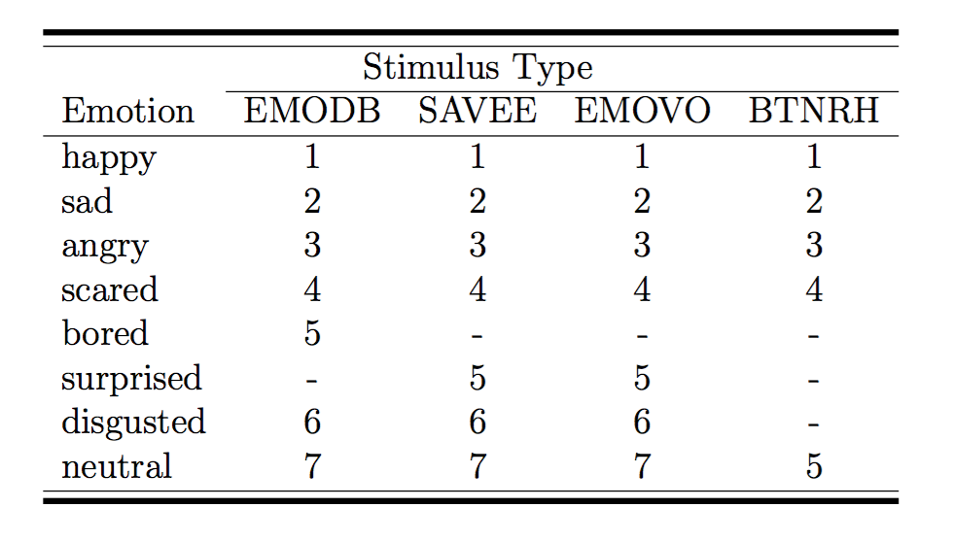
  Experimental Setup: Training and Test
The labels of the training and the test data were encoded as one-hot vectors

Slide 31
  Experimental Setup: Training and Test
Cross entropy as loss function
Adam algorithm to minimize loss function
Dropout with various probability for regularization
The number of training epochs was varied between 100 to 4000. The favorable training epoch was set to 100 due to the computation and time expenses

Slide 32
  Experimental Setup: Training and Test
To implement the CNN:
  TensorFlow (an open-source library written in Python and C++) was used as as the programming framework
Each fold of the networks developed in this study took between 30 minutes to 2 days to be trained using Graphics Processing Units (GPUs) on Crane cluster of the Holland Computing Center at University of Nebraska-Lincoln

Slide 33
Outline
Related Work
Experimental Setup
Results
Discussion
Conclusion
Ongoing and Future Work

Slide 34
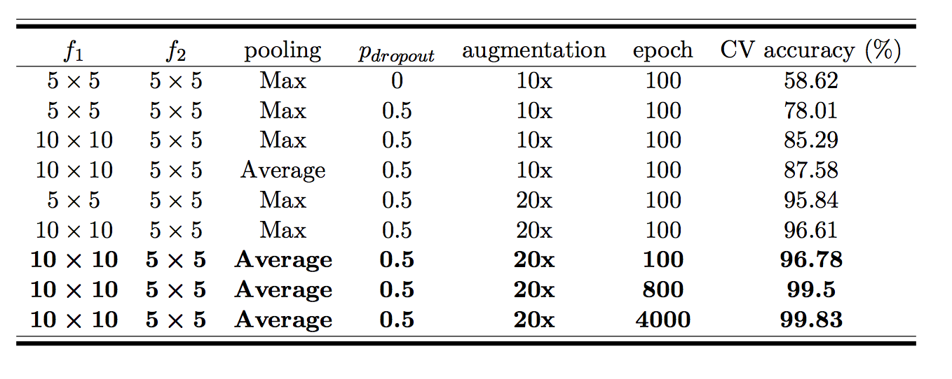
Results: EMODB Database

Slide 35
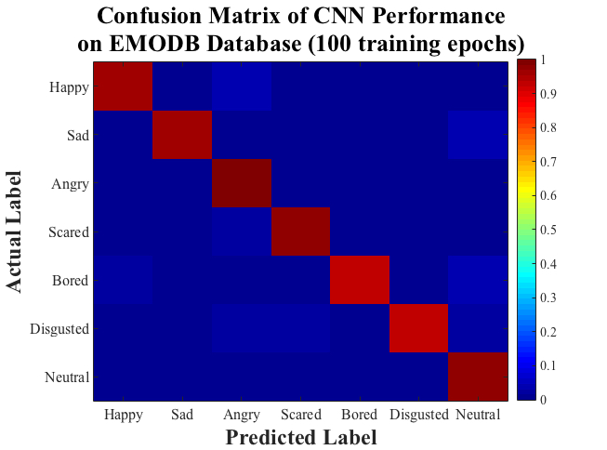
Results: EMODB Database

Slide 36
Results: EMODB Database

Slide 37
Results: EMODB Database

Slide 38
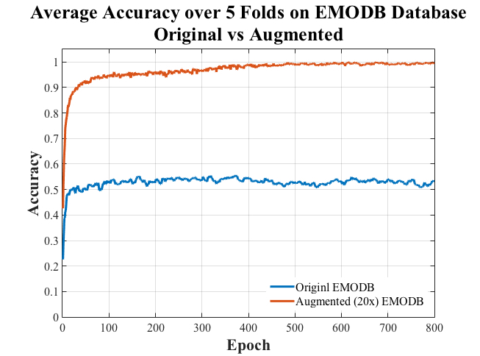
Augmentation Effect: EMODB

Slide 39
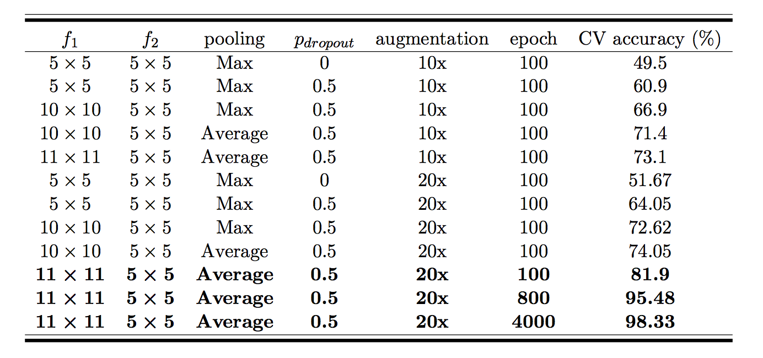
Results: SAVEE Database

Slide 40
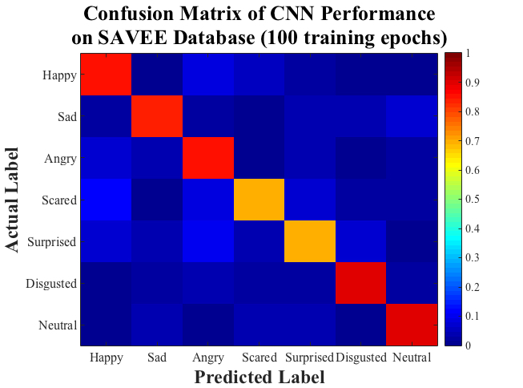
Results: SAVEE Database

Slide 41
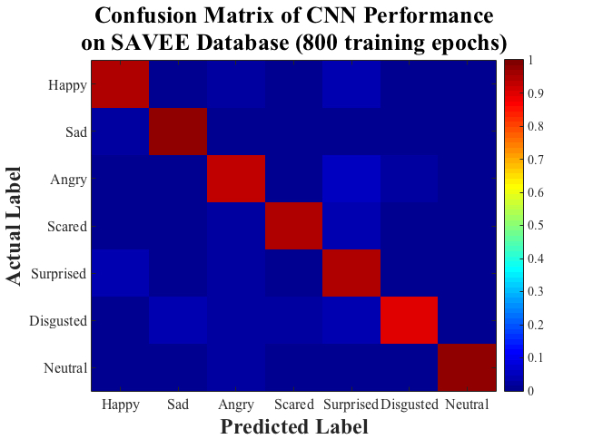
Results: SAVEE Database

Slide 42
Results: SAVEE Database

Slide 43
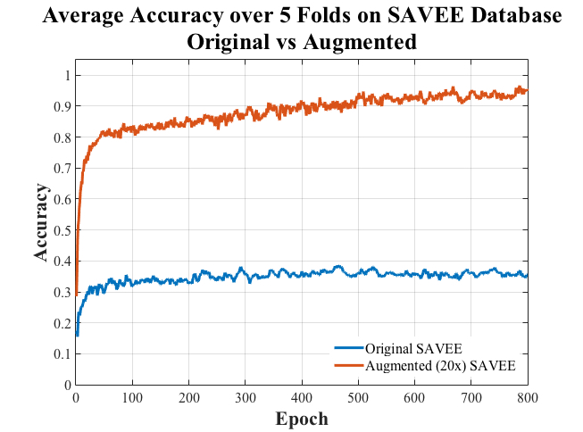
Augmentation Effect: SAVEE

Slide 44
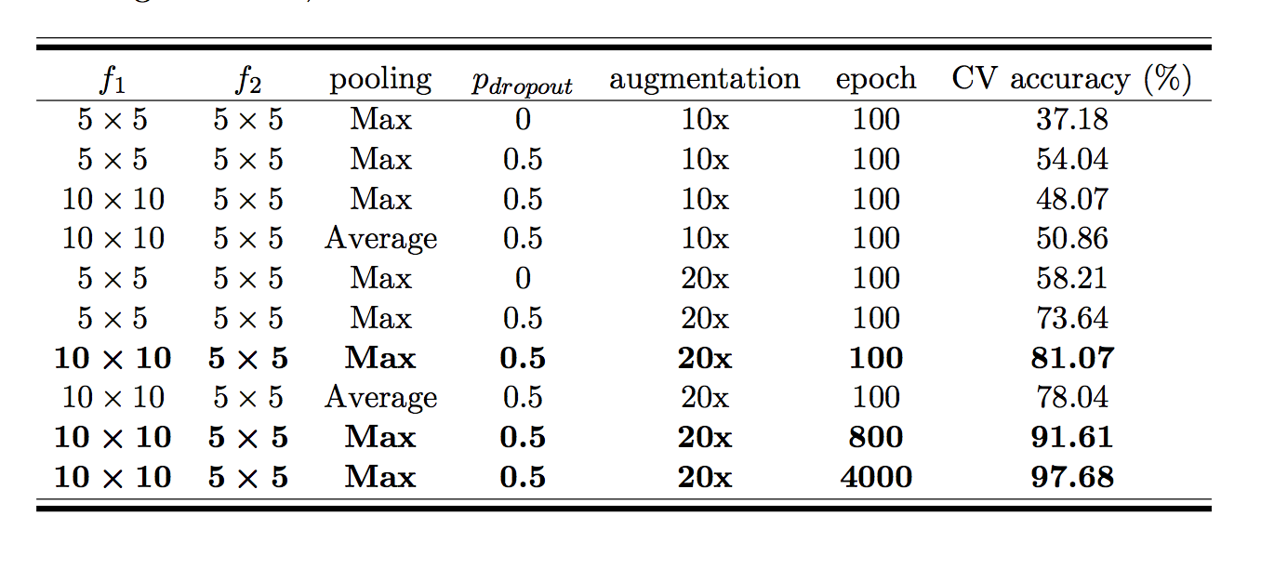
Results: EMOVO Database

Slide 45
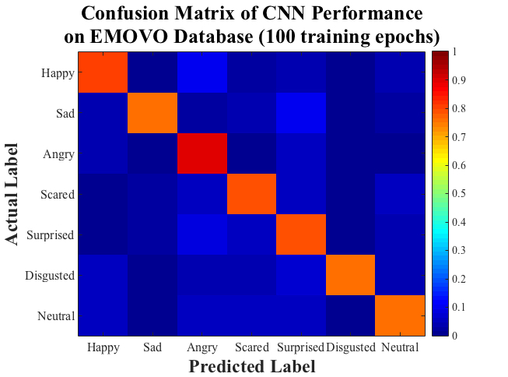
Results: EMOVO Database

Slide 46
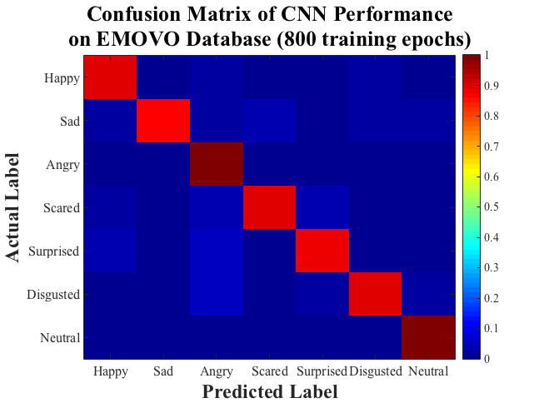
Results: EMOVO Database

Slide 47
Results: EMOVO Database

Slide 48
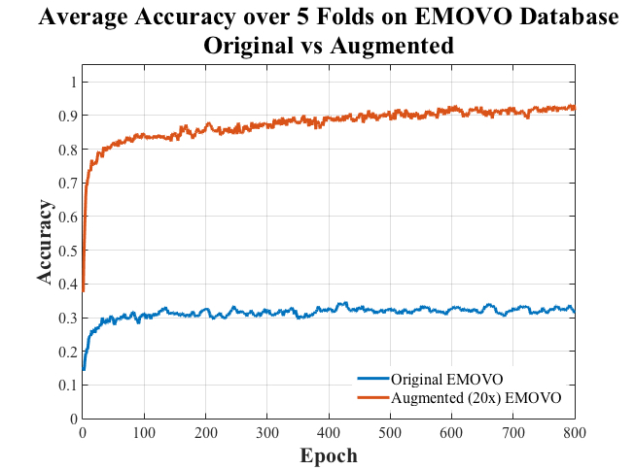
Augmentation Effect: EMOVO

Slide 49
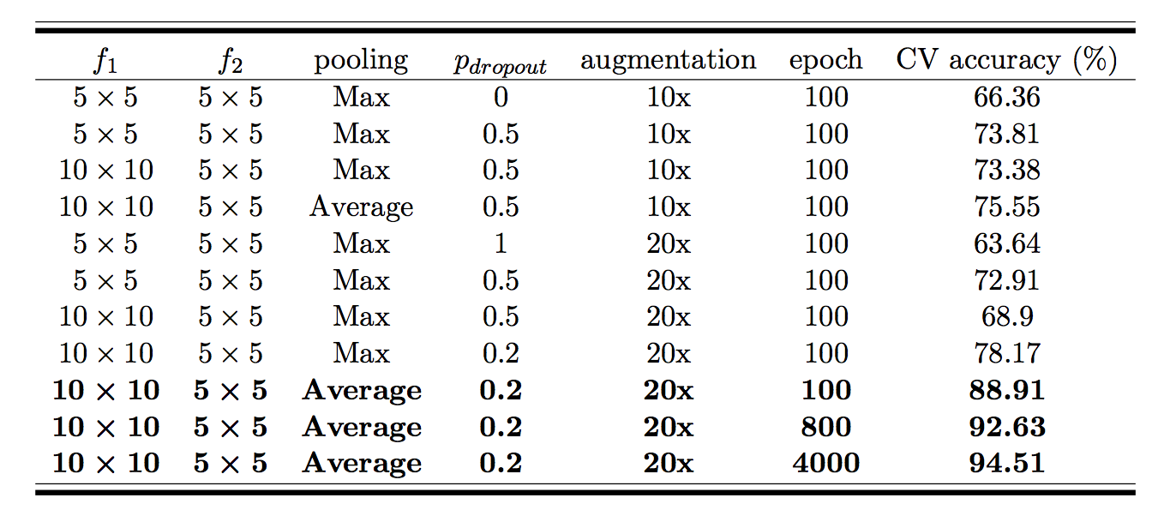
Results: BTNRH Database

Slide 50
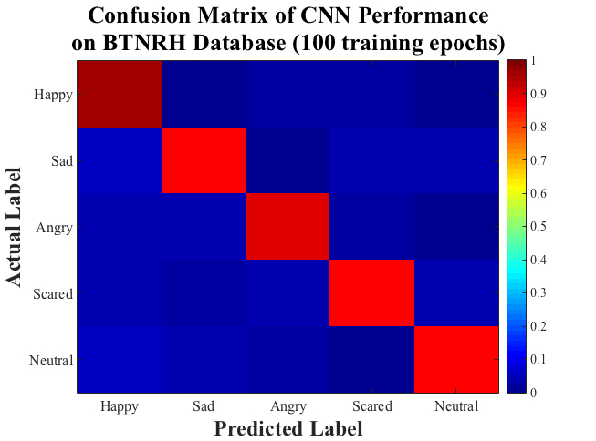
Results: BTNRH Database

Slide 51
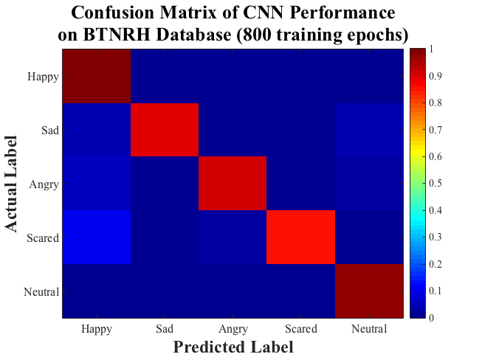
Results: BTNRH Database

Slide 52
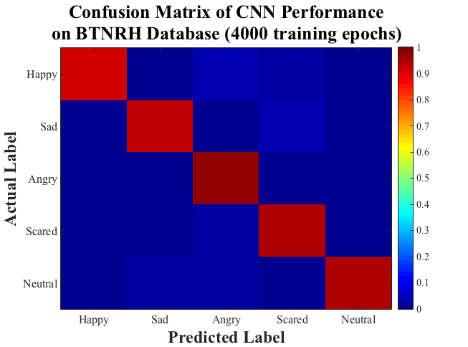
Results: BTNRH Database

Slide 53
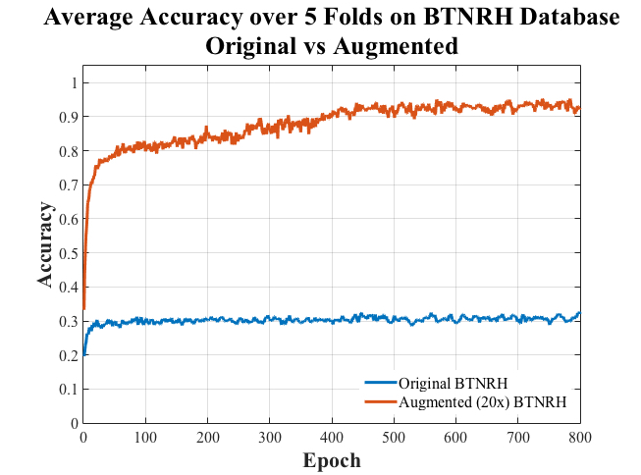
Augmentation Effect: BTNRH

Slide 54
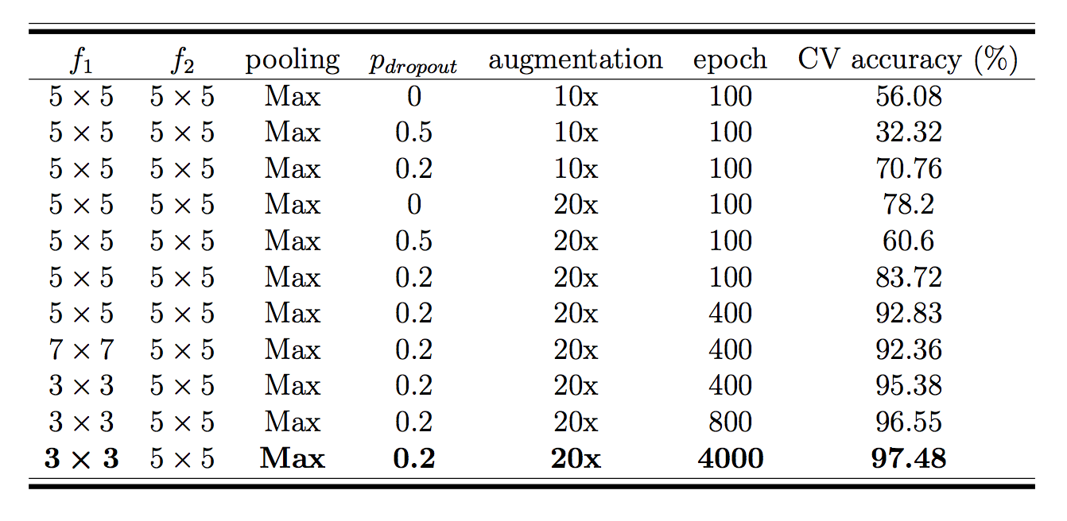
Results: All-inclusive Database
Notes:
All four databases used in the current study were consolidated into a one big database. In a trial and error approach, we found that the dropout probability of 0.2 compromises the best between overfitting and underfitting the data. Moreover, the CNN models with max pooling had higher performance than the CNN models with average pooling.

Slide 55
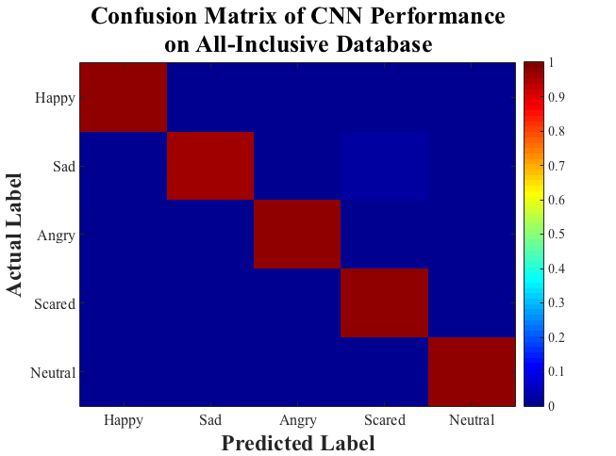
Results: All-inclusive Database

Slide 56
Outline
Related Work
Experimental Setup
Results
Discussion
Conclusion
Ongoing and Future Work

Slide 57
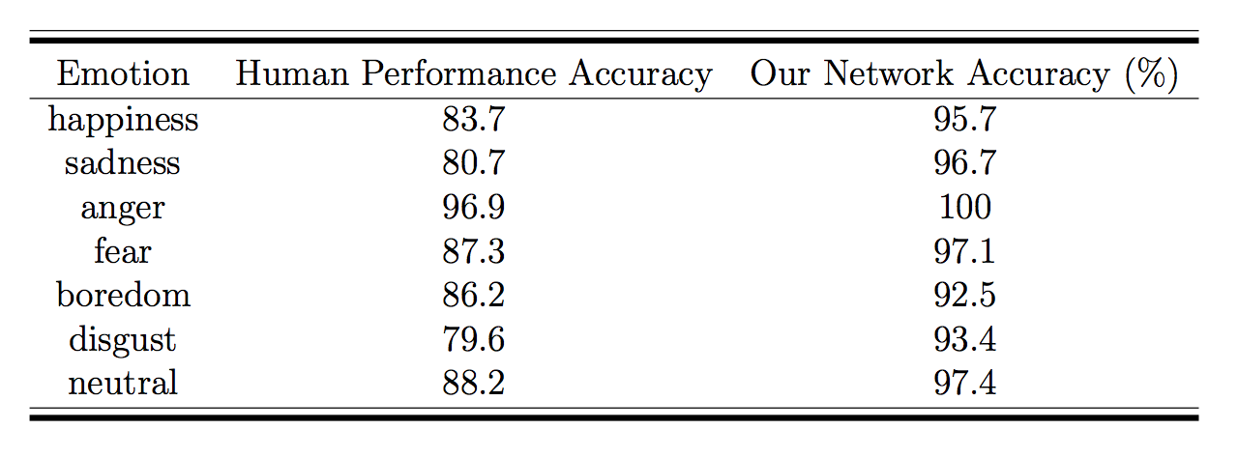
Human Performance vs EmoConv on EMODB Database
(100 training epochs)

Slide 58
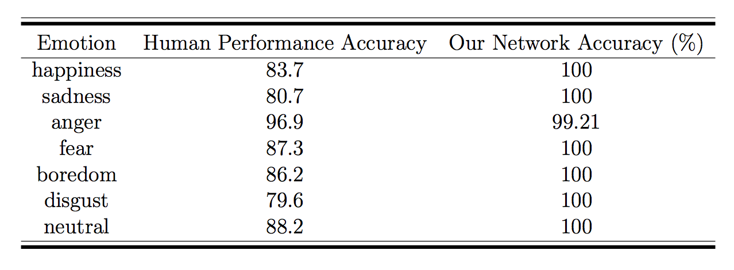
Human Performance vs EmoConv on EMODB Database
(4000 training epochs)

Slide 59
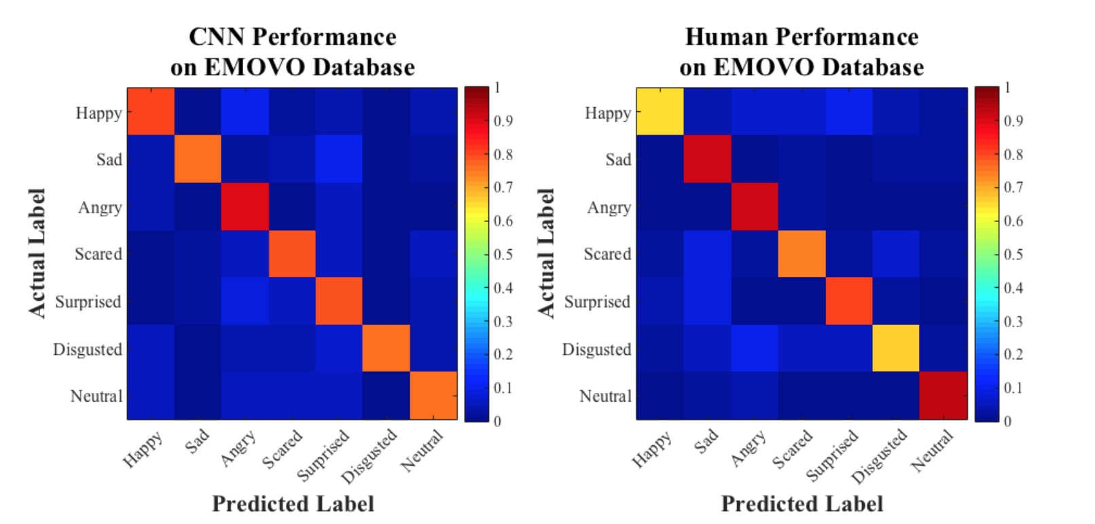
Human Performance vs EmoConv on EMOVO Database
(100 training epochs)

Slide 60
Human Performance vs EmoConv on EMOVO Database
(4000 training epochs)

Slide 61
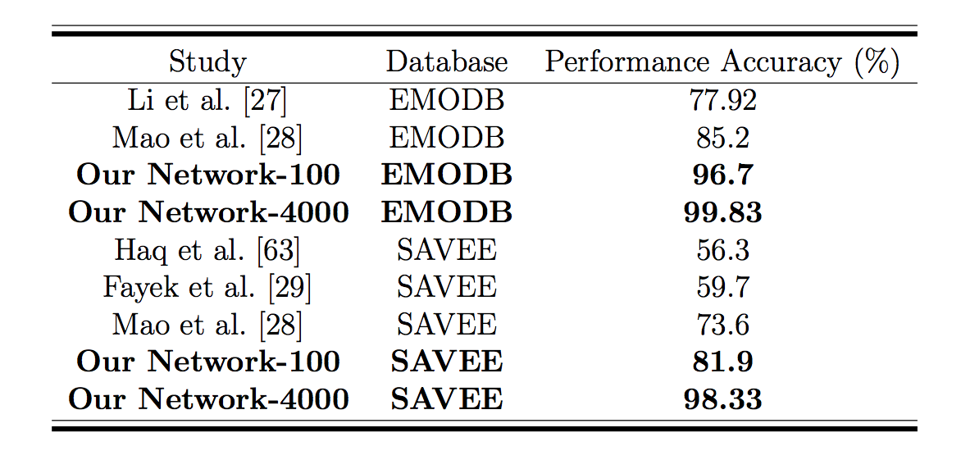
Comparison with Prior Work

Slide 62
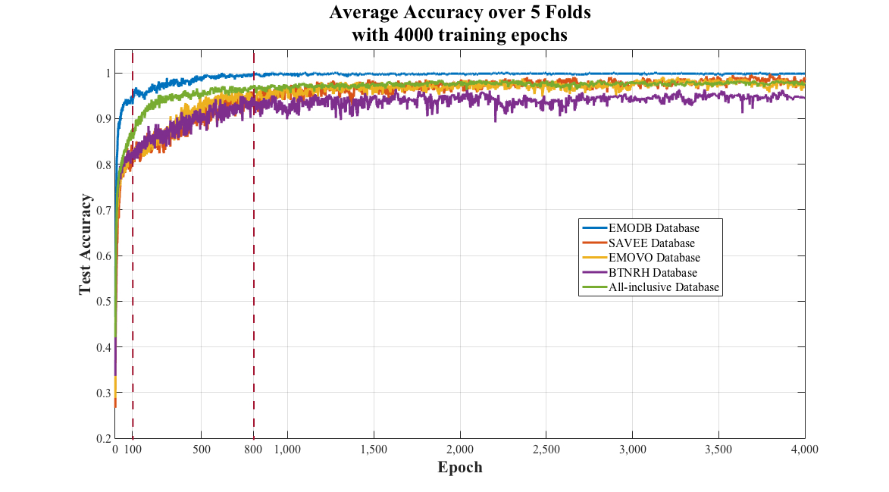
Why 4000 Training Epochs?

Slide 63
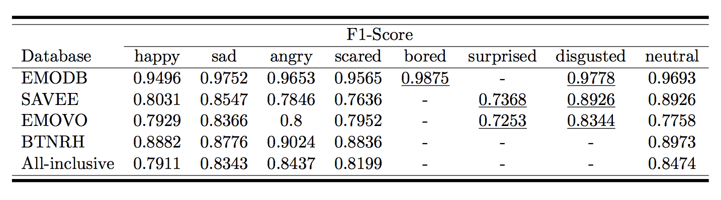
F1 Scores after 100 Training Epochs

Slide 64
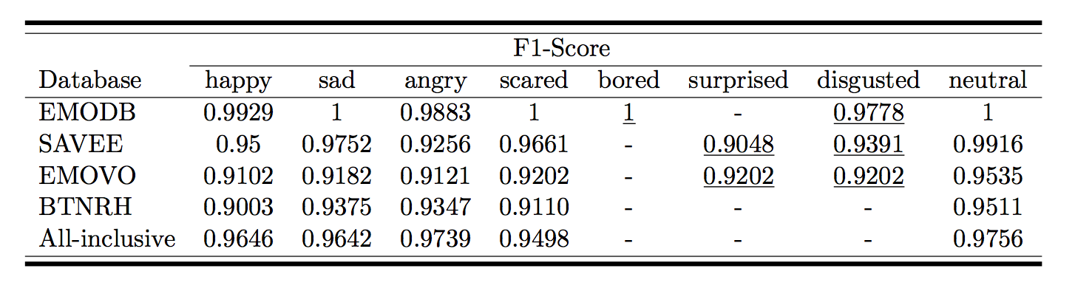
F1 Scores after 800 Training Epochs

Slide 65
Ineffective Modifications
Language-dependent models:
  Increasing the depth of convolutional layers
  Changing the kernel size of the filters within the second convolutional layer
  Varying the number of filter within the convolutional layers
Language-independent model:
  Using average pooling in lieu of max pooling

Slide 66
Outline
Related Work
Experimental Setup
Results
Discussion
Conclusion
Ongoing and Future Work

Slide 67
Conclusion
CNNs with a standard topology are capable of learning the underlying emotional features of speech signals from their low-level representation irrespective of the gender and the language of the speakers:
  Using wide-band spectrograms
  Employing large data augmentation
  Various training epochs
  Dropout regularization

Slide 68
Outline
Related Work
Experimental Setup
Results
Discussion
Conclusion
Ongoing and Future Work

Slide 69
Ongoing and Future Work
Incorporating narrow-band spectrograms as the second channel of the input data
Incorporating multimodal databases to tackle decoding emotions in daily-life speech signals
Leave- one-out cross-validation to train and test the performance of the CNN models on the all-inclusive database
Notes:
left hemisphere would show a preference for processing of rapid temporal information in sound
right hemisphere is more sensitive to spectral information.

Slide 70

Acknowledgment
I would like to express my deepest and sincerest gratitude to my advisor, Dr. Stephen Scott. I am greatly indebted for all his support and guidance.
I would also like to thank my committee members, Dr. Vinod Variyam and Dr. Tom Carrell. I am greatly thankful to them for consenting to be my committee members, reading this thesis, and providing me with their suggestions and feedback.

Slide 71
Acknowledgment
Special thanks to Dr. Monita Chatterjee and her colleagues at Boys Town National Research Hospital for sharing their speech emotion database with us.
Also, I would like to express my appreciation to all the faculty and staff members.
I would like to pay special warmth and appreciation to my family and friends.

